Slide 1

GROUP-6
GROUP MEMBERS:-
Shahrukh Padaniya
Rohan Yadav
Swapnil Sevak

Slide 2
Getting Started with the Yocto Project

Slide 3
What is Yocto project ?
- It is an open-source collaboration project that provides templates, tools and methods to help create custom linux based systems for embedded products regardless of hardware architecture.
- It can create linux images for all the major hardware architecture including x86, ARM, MIPS and PowerPC.
- It is an umbrella project collaborated by the open-source community and industry for developing custom linux images.
- It is hosted by Linux Foundation.

Slide 4
Yocto project is backed by many organizations. Some of them are :
Silicon Vendors - TILERA, Intel, LSI, freescale semiconductor, CAVIUM NETWORKS, Texus Instruments
OSVs – WIND RIVER, montavista, timesys, Mentor Graphics
Embedded tools, Consulting services – RidgeRun, Secret Lab, SAKOMAN, Panasonic, DELL, openembedded
Anyone can become an official partipating organization by contacting the Linux Foundation.

Slide 5
Benefits of Yocto Project
Reuse software stack for future devices
Can be developed using one common Linux OS for all major architectures
We need to just update one line in the config file and rebuilt, when we change hardware platform
Start with validated collection of software and libraries
Access to great collection of application development tools like eclipse-plugin
Easy transition to a commercial embedded Linux

Slide 6
Yocto Project Build System ​
Poky
(built system)
Bitbake
(task executor and scheduler)
Metadata
(task definations)
Configuration (global definitions of variables)
Classes (inheritance of build logic, packaging, etc)
Recipes (defines individual piece of software to be build)

Slide 7
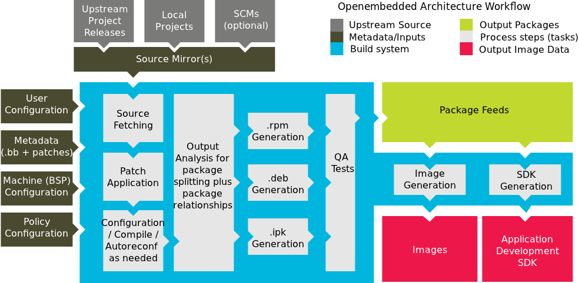
Built System Workflow

Slide 8
Start guide
1) First download poky and extract the file.
2) Go to poky and type following command to build a Linux image-
source oe-init-build-env
Select machine by following commands-
cd conf
nano local.conf
Uncommant the machine to select
After which run following command and wait-
bitbake core-image-sato
3) To run "core-image-sato" on an emulator, we need to type following command-
runqemu qemux86
4) To exit, enter the command – "shutdown"
​

Slide 9
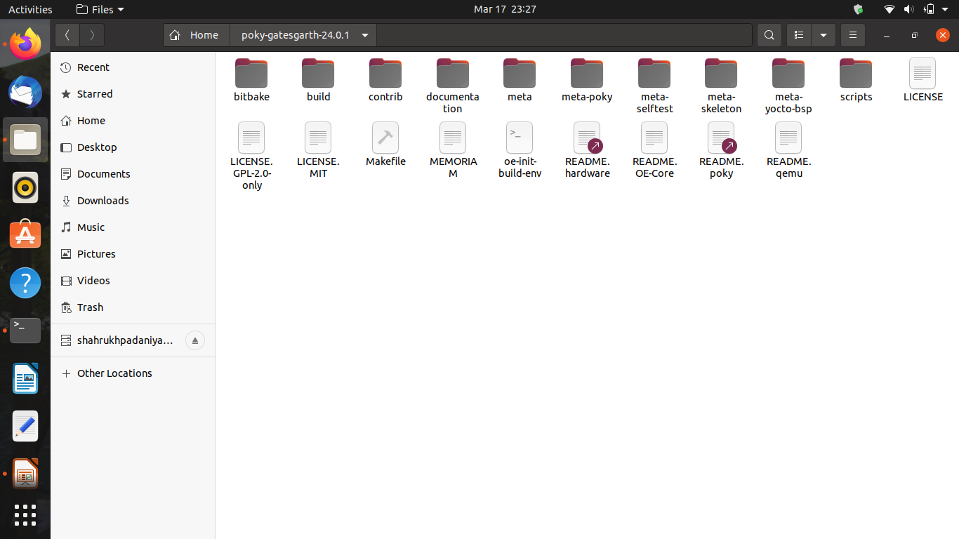
Subdirectories in poky folder

Slide 10
Bitbake- bitbake command and sources are kept here
Build- dynamically generated during builds
downloads- all up-steam sources gets downloaded here
sstate-cache-we store compiled output that can be reused during successive build is stored here
temp- builds are performed here
conf- it has local.conf and bblayer.conf files
Documentation- sources to our documentation are kept here
Meta- main matadata files of build system are located here
Recipes- we store recipe file here
Classes- all bitbake classes are present here
Conf- different kind of configuration files for the build are present here
Machine- machine configuration files are present here(hardware characteristics)
Script- support scripts that the build system uses are stored here
​

Slide 11
Recipe
​
Recipe contains information about a single piece of software.
This information includes-
The location from which to download the unaltered source
Any source patches to be applied to that source (if needed)
Which special configuration options to apply
How to compile the source files
How to package the compiled output
​

Slide 12
Recipe build steps
Do_fatch
Do_unpack
Do_patch
Do_configure
Do_compile
Do_install
Do_package
​​

Slide 13
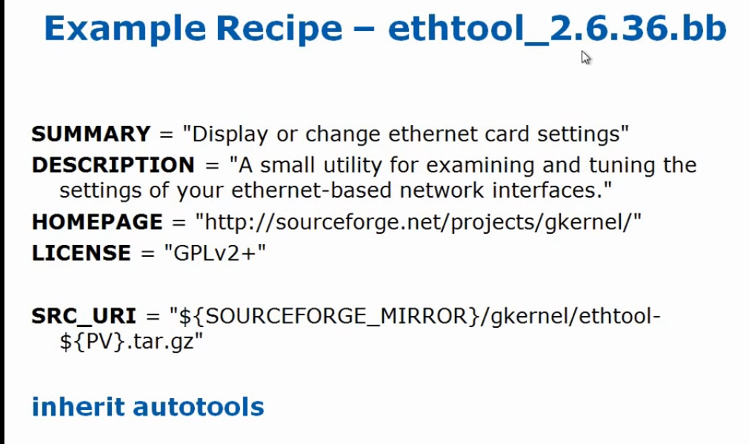

Slide 14
Layers
​​
Layers are repositories that contain related metadata (i.e. sets of instructions) that tell the OpenEmbedded build system how to build a target.
Yocto Project's layer model facilitates collaboration, sharing, customization, and reuse within the Yocto Project development environment.
Layers logically separate information for your project.
For example, you can use a layer to hold all the configurations for a particular piece of hardware. Isolating hardware-specific configurations allows you to share other metadata by using a different layer where that metadata might be common across several pieces of hardware.
​​

Slide 15
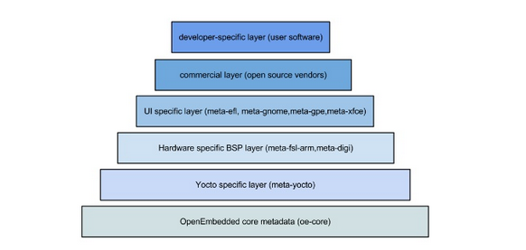
Layers​
​​​

Slide 16
References:-
Getting Started with the Yocto Project - New Developer Screen cast Tutorial
https://youtu.be/zNLYanJAQ3s​​
https://www.yoctoproject.org/
​​​​

Slide 17





The End​
​​​Thank You

